Slide 1
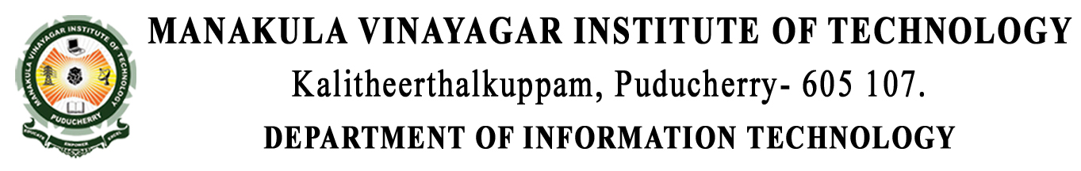
CHHATRA VISHWAKARMA AWARDS 2019
CODE BUSTERS
Application ID : VISH20195180
Project Title : Tribal Welfare Application
Mentor : Mr. K. Vijiyakumar
Team Members
Amarnath. G
Giridharan. S
Manikandan. K
Marie Augustin Raj. A

Slide 2
CONTENT
Abstract
Introduction
Problem Statement
Existing System
Proposed System
System Architecture
Modules
Artisans
Agencies of MoTA
Commoners
Outputs / Screenshots
Use-Case Diagram
Conclusion
Reference

Slide 3
ABSTRACT
Rural development signifies both the economic amelioration of mankind as well as greater social amendment.
In order to furnish a better prospect of economic and social expansion of the Tribes, a digital platform is needed for accessing their merits.
It entitles the artisan to commerce their products to different locale in and around India.
The propound project work is to develop a mobile application that permit them to upload their craft work as an image / video that could assist the agencies of Ministry of Tribal Affairs (MoTA) to perceive their work.
Furthermore, it proffers a chat section for productive interrelation among the agencies, tribes and common people (Commoners).
It render the Agencies of MoTA to merge with the artisans in reference to skill up-gradation training, branding and marketing support.
The artisans can moreover post their queries concerning the training session and other queries.

Slide 4
MOBILE APPLICATION
A mobile app or mobile application is a computer program or software application designed to run on a mobile device such as a phone/tablet or watch.
Apps are generally small, individual software units with limited function.
Each app provides limited and isolated functionality such as a game, calculator or mobile web browsing.

Slide 5
ANDROID
Android is a Mobile Operating System developed by Google, based on Linux Kernel and open source software.
Developed by Google and later the Open Handset Alliance (OHA).
There are more than 4,00,000+ apps in android market.
Allows writing managed code in the Java language.
STORES: Google play, SlideME, Opera Mobile Store, Amazon App Store, Mobango.

Slide 6
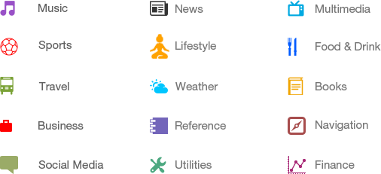
CATEGORIES OF APPLICATIONS

Slide 7
FIREBASE
It was a startup called Envolve.
As Envolve, it provided developers with an API that enabled the integration of online chat functionality into their website.
In April 2012, Firebase was created as a separate company that provided Backend-as-a-Service with real-time functionality.
After, it was acquired by Google in 2014, Firebase rapidly evolved into the multifunctional behemoth of a mobile and web platform that it is today.

Slide 8
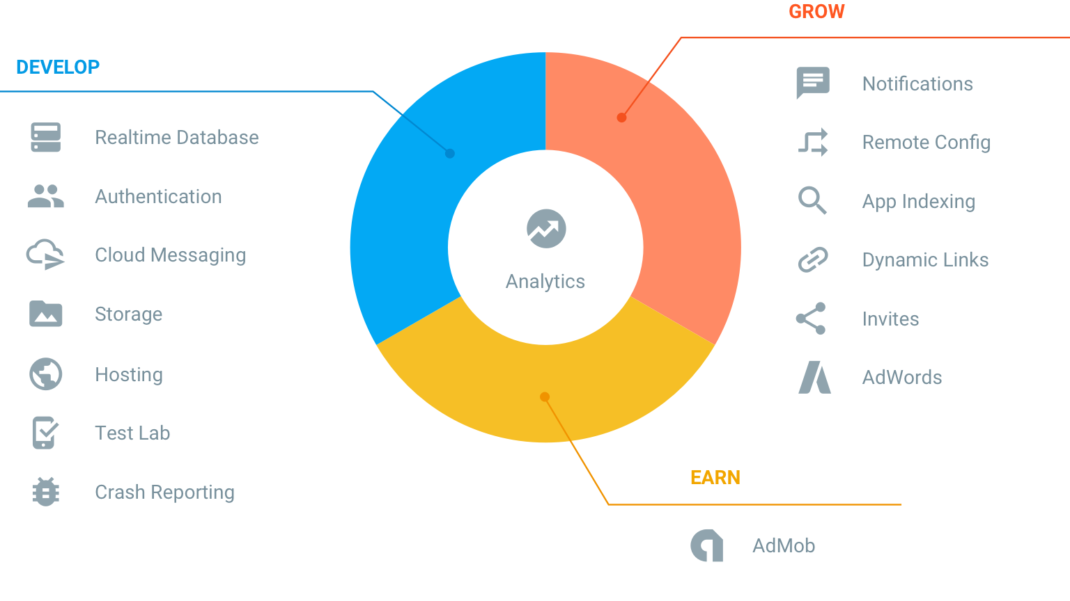
FIREBASE SERVICES
Develop & Test your App.
Grow & engage audience.

Slide 9
Cont..
Real-time database – It is a cloud database.
Cloud storage – It is used for easy and secure file transfer and also to store the images, videos, audios, or other information contents. Hence, it is a cost-efficient object/file storage system.
Cloud messaging – It is used to send message or to establish communication among the users without any payments.
Authentication – It provides security to the user in a simpler way through the email or social media accounts.
Hosting – It is a production-grade web content that facilities the developers.
Remote configuration – It is used to customize (i.e. to change the appearance) the application without requiring the user to download an application update.

Slide 10
PROBLEM STATEMENT
Tribal people are the one who are unaware of the social and economic life.
In order to furnish a better India and to eradicate the gap between the local artisans and the agencies of MoTA, a mobile application can be developed.
The artisans can expose their skills to the agencies through the provided platform, in such a way that they are benefited.
The role of the agencies is to support the artisans regarding training, marketing and branding of their products.

Slide 11
Cont..
Thus a digitalized platform for the tribal people and agencies of MoTA can be provided with the multi-lingual and voice assist features.
A platform for marketing of product by the agencies of MoTA to the commoners can bring more economic stability for the local artisans.
The common people can go through the skills possessed by the artisans through an application.

Slide 12
EXISTING SYSTEM
Marketing of the artisans work are done through only third party whereas they does not have a direct contact among the high esteem government agencies.
Also the Artisans do not get any trainings and instructions from the government agencies for their welfare.
There is an application named “TRIBAL DIARIES” which have a likes of 10cr of people and also it is an application which only a normal people can use. It is a kind of documentary which talks about the daily life and struggles of the tribal peoples who come forward to give their voices.

Slide 13
PROPOSED SYSTEM
The mobile application is mainly based on the promotions and welfare of the tribal people (Artisans). It helps the Artisans to directly have a link with the agencies of Ministry of Tribal Affairs. By which they can also get trainings and promotions of their work easily with respect to their hidden skills.
We are planning to make it in a simpler way where the Artisan can upload their work as an Image/Video rather than explaining it, since some of the tribal people lacks communication skills. They can also ask their queries in the chat application.
This application also provides a voice-note feature for query session who wants to speak out rather than typing it.

Slide 14
Cont..
The MoTA can sell the products made by the Artisan to the Commoners for their economic development.
This allows the commoners to view and buy the products.
The commoners can also view and understand the skills of the artisan and recommend them to the Agencies of MoTA for their knowledge upgradation.

Slide 15
MODULES
Artisans.
Agencies of MoTA.
Commoners (Other than Artisans).

Slide 16
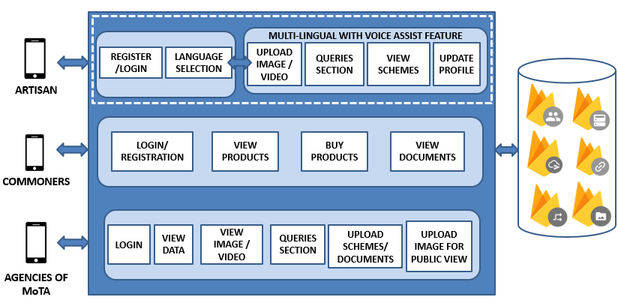
SYSTEM ARCHITECTURE

Slide 17
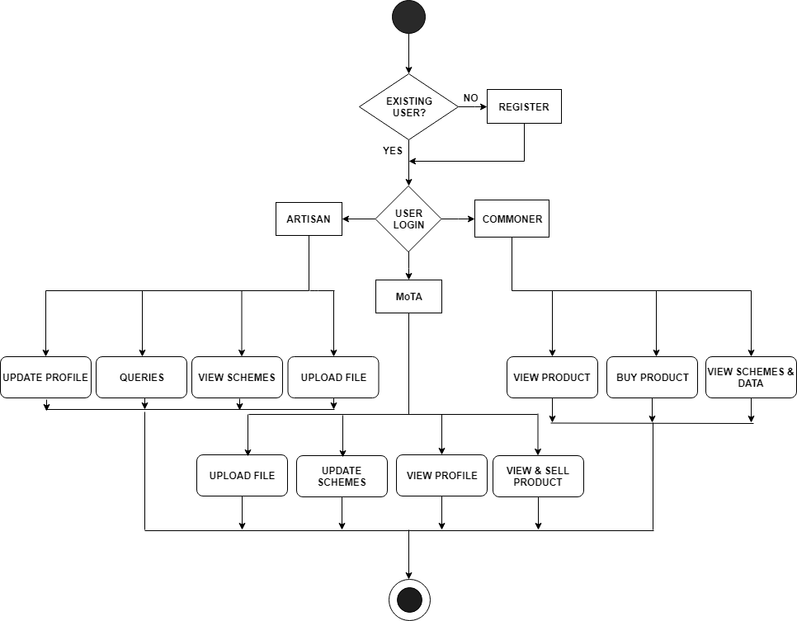
FLOW DIAGRAM

Slide 18
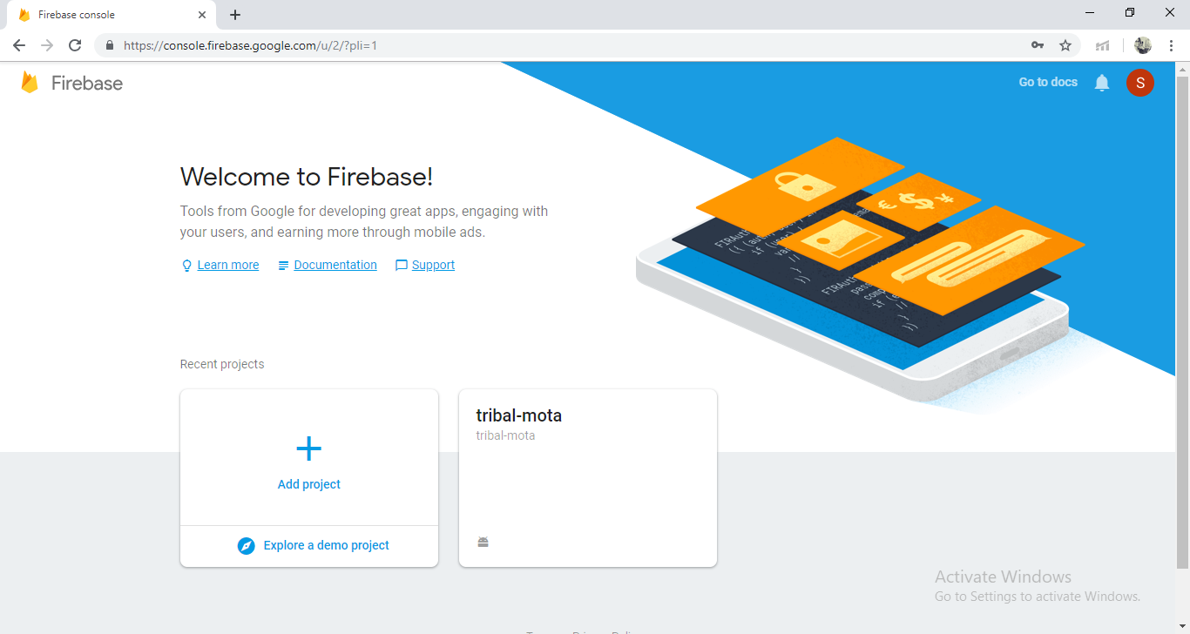
FIREBASE CONSOLE OF THE PROJECT

Slide 19
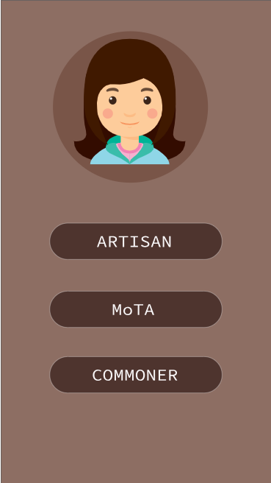
INITIAL PAGE
The initial page consists of three buttons
Artisan
MoTA
Commoner
The buttons are used to choose the type of user to access the application.

Slide 20
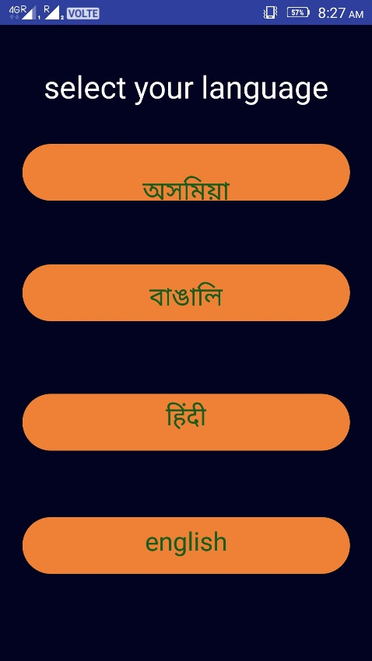
LANGUAGE SELECTION PAGE FOR ARTISAN
The languages are selected by the artisan based on their choice.
The languages are stored as a XML file under the res folder.
These are invoked using the JAVA code.
The application is provided with three languages (Hindi, English, Tamil).

Slide 21
Cont..
START
LOGIN / REGISTRATION
ARTISAN REGISTRATION
ARTISAN LOGIN
MoTA LOGIN
COMMONER REGISTRATION
COMMONER LOGIN
1
2
3
4
5
1, 2, 3, 4 & 5 are connectors.

Slide 22
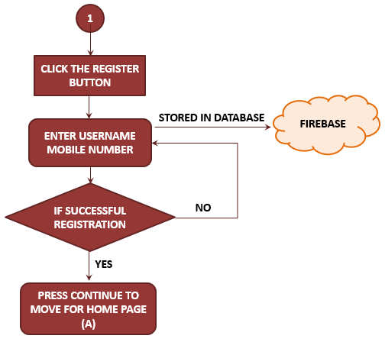
ARTISAN’S REGISTRATION
To register as a new user the artisan need to click the register button.
After clicking the button the details (Username and Mobile number) must be filled.
The mobile number acts as a login credential for the artisans.
The details will be stored in the Firebase Database.

Slide 23
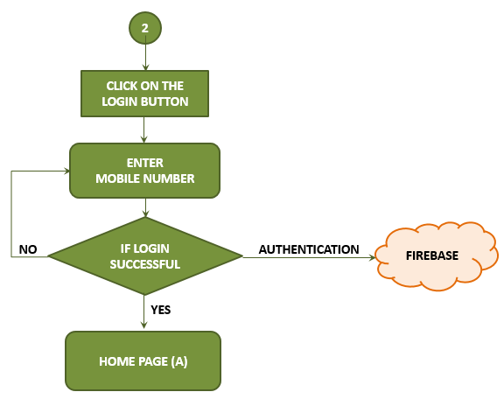
ARTISAN’S LOGIN
If the user logged out, he / she need to login once again.
Since the artisans are illiterate, the mobile number can be used for authentication purpose.
If the user is authenticated user the login will be successful or else the login fails.
This can be done from the cloud authentication service.

Slide 24
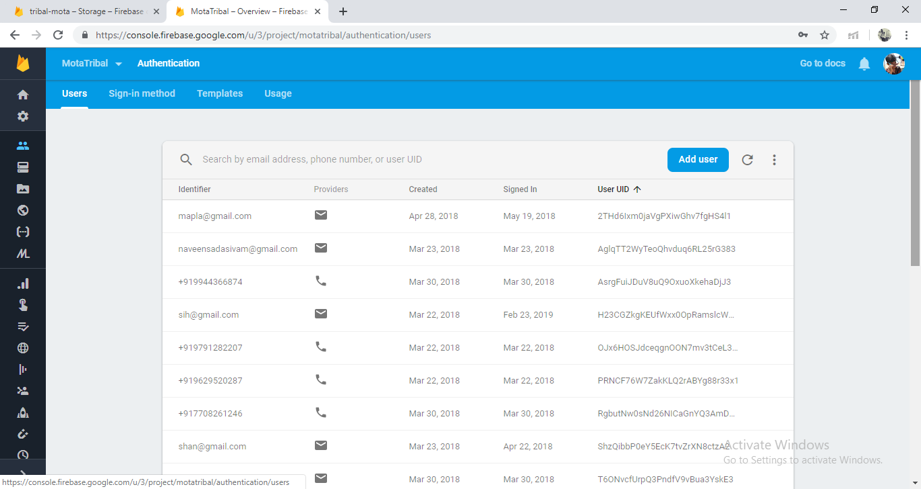
HOW THE DETAILS ARE ORGANIZED IN DATABASE

Slide 25
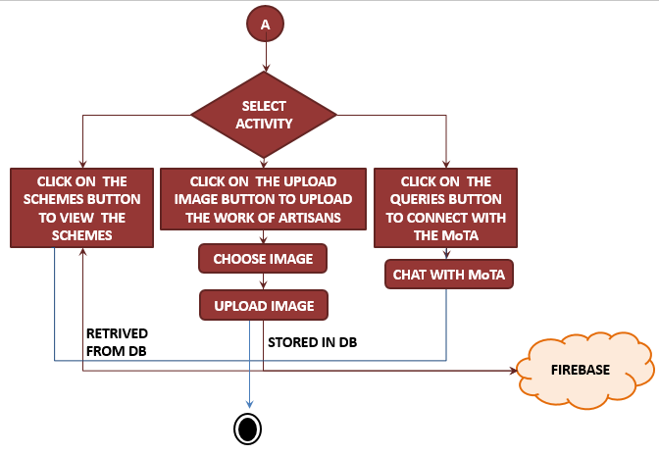
HOME PAGE OF ARTISAN

Slide 26
Description
The artisan’s home page consists of three buttons with different functionalities.
To view the schemes uploaded by the MoTA, the artisan need to click on the schemes button.
Once the artisan clicks the button the schemes page will be opened.
To upload the art work of the artisan, they need to click on the upload image button, where the page will be directed to choose a file and upload that. This will be stored in firebase storage.
In the query section provided the artisan can interact with the agencies of MoTA.

Slide 27
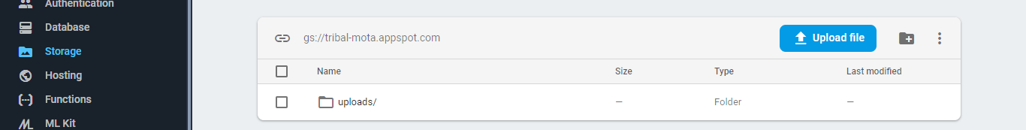
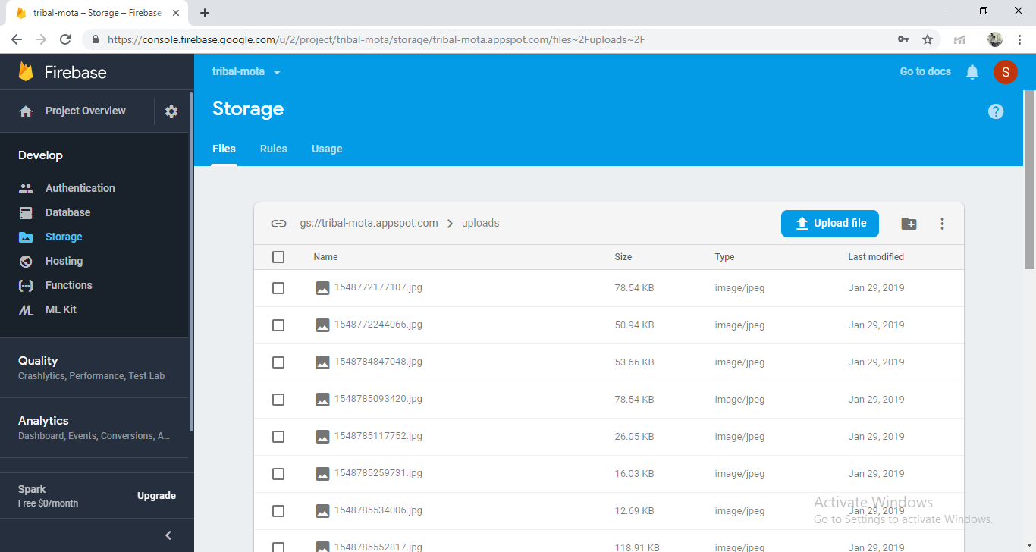
HOW THE UPLOADED IMAGES ARE STORED IN STORAGE

Slide 28
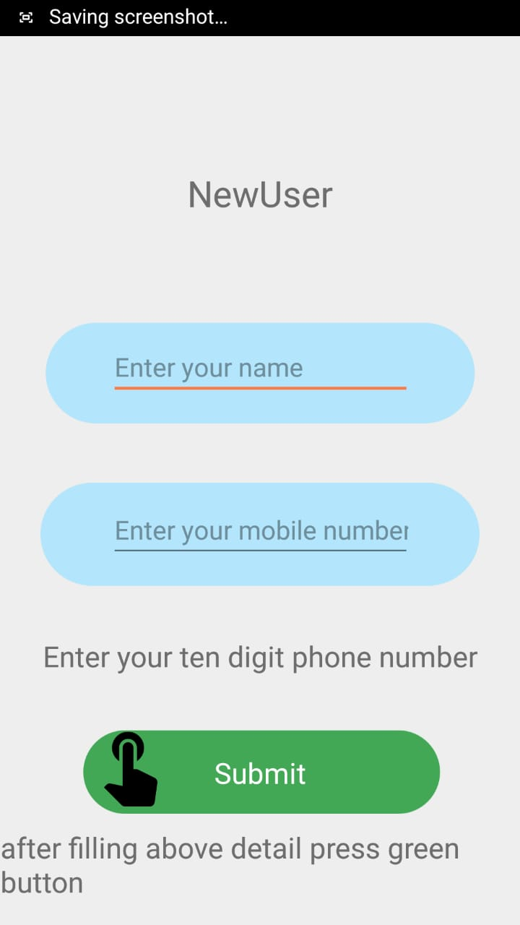
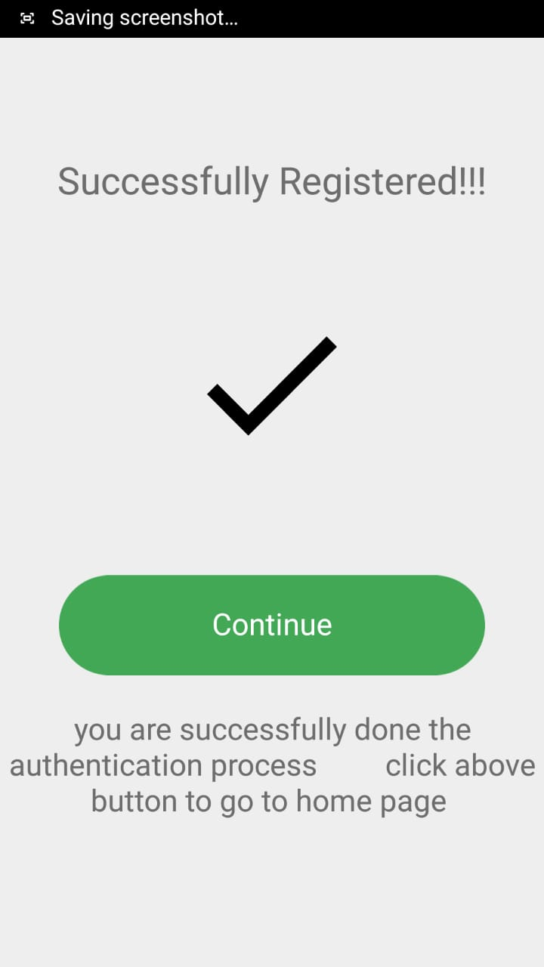
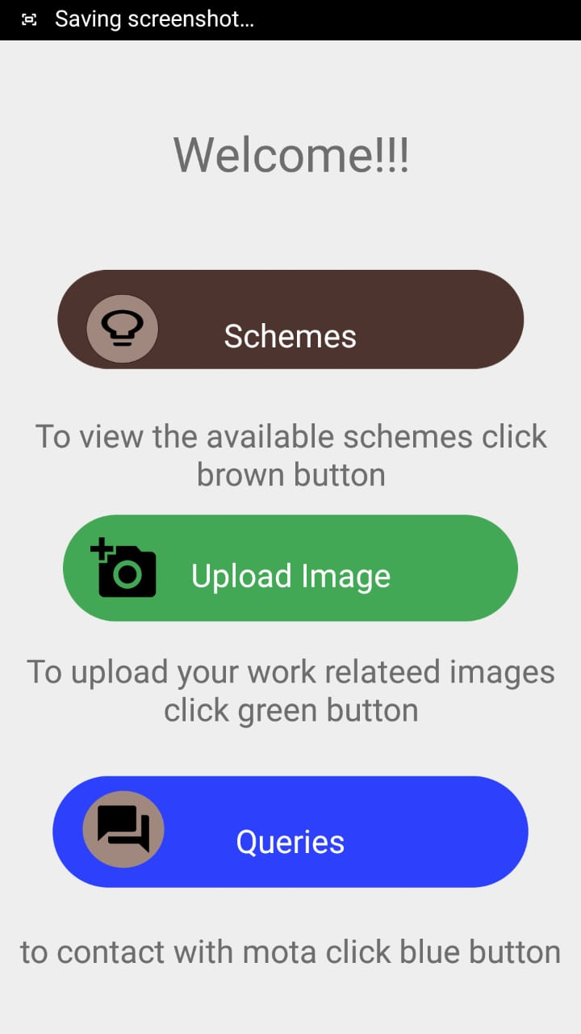
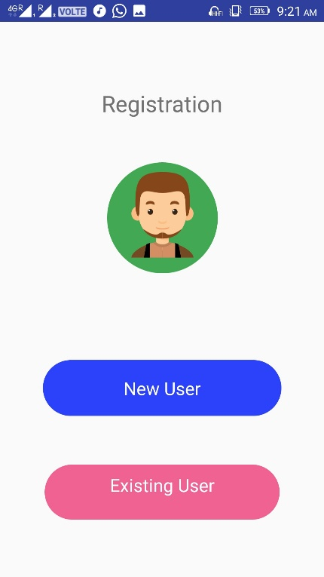
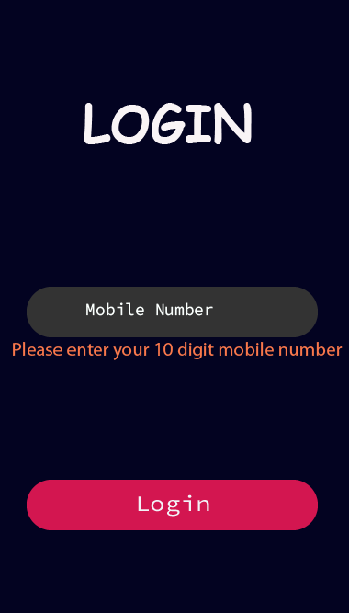
SCREENSHOTS OF
ARTISANS

Slide 29
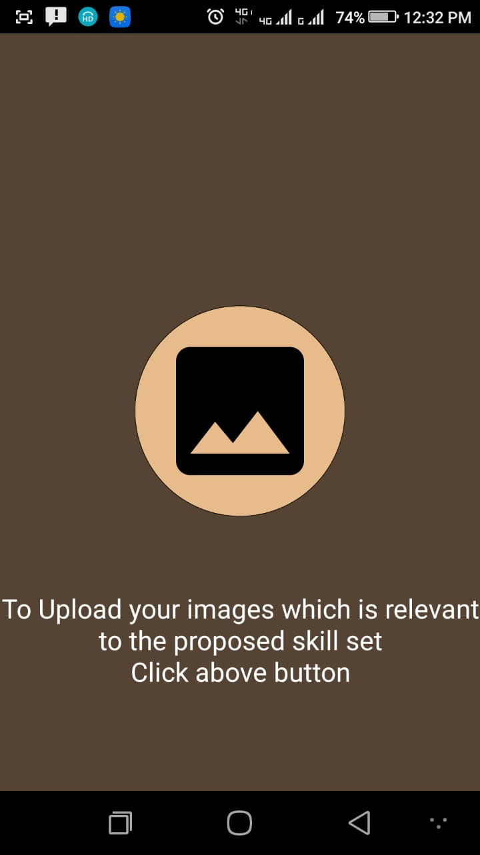
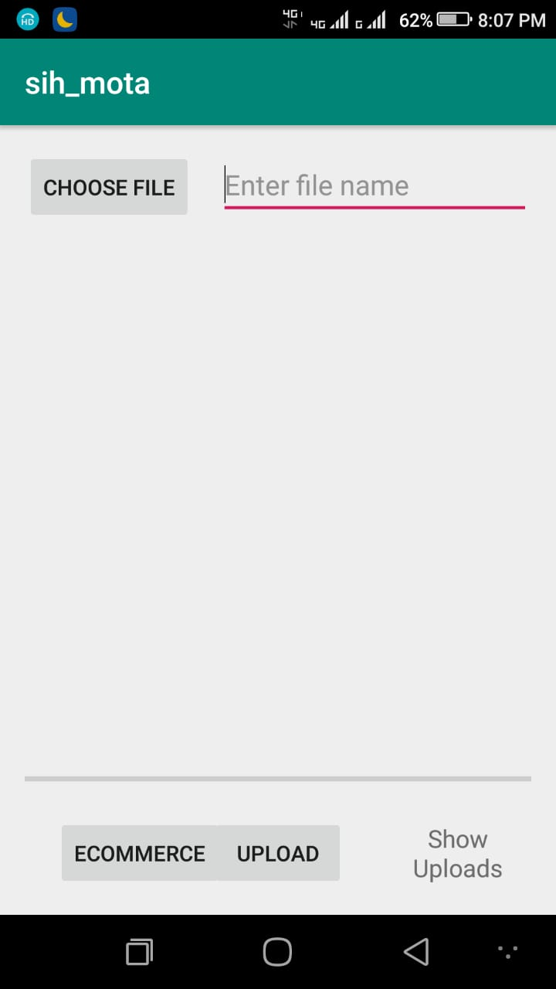
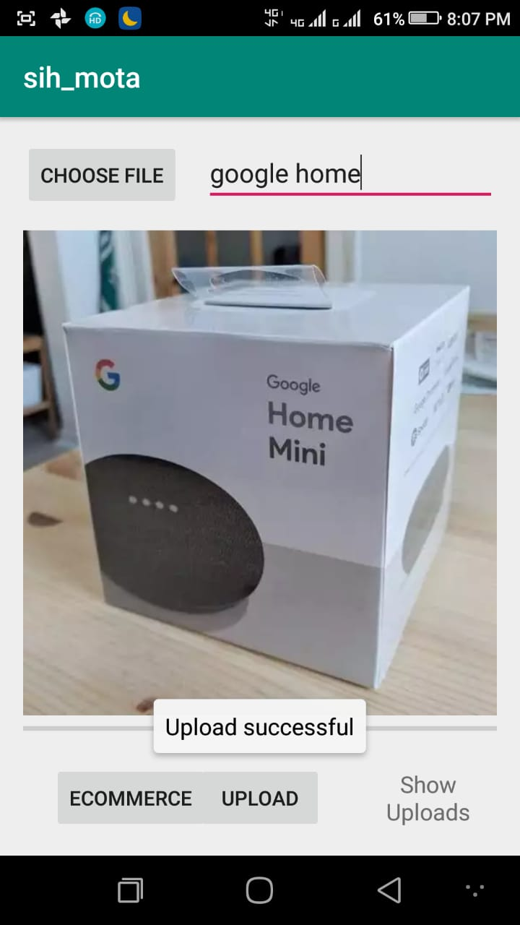
Cont..

Slide 30
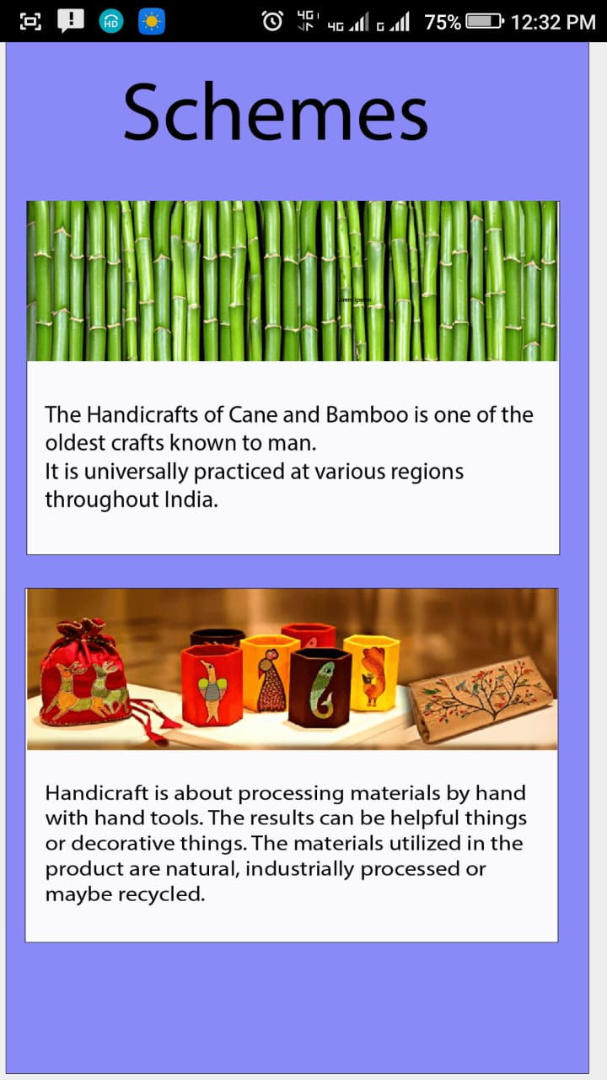
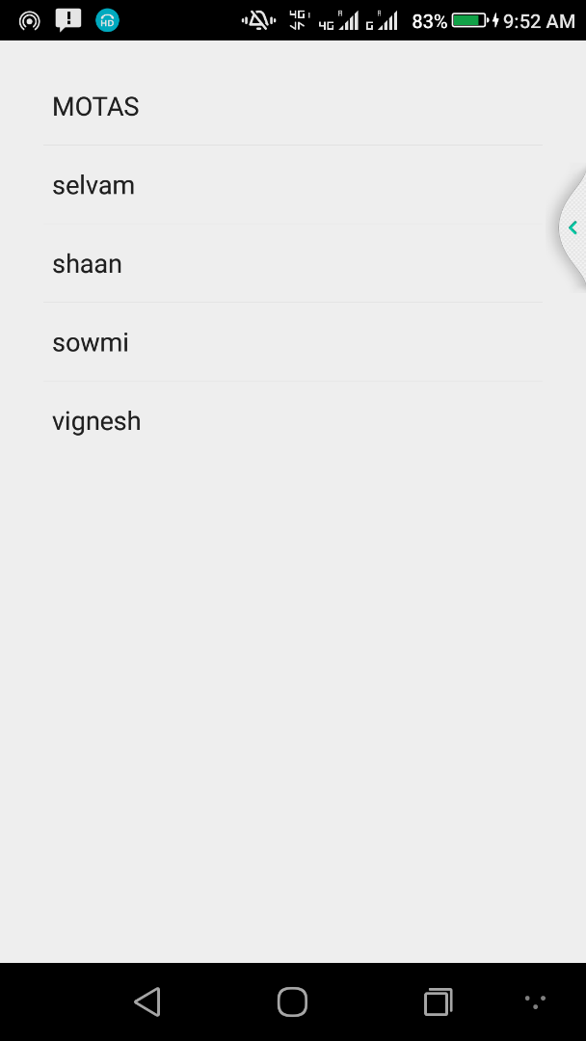
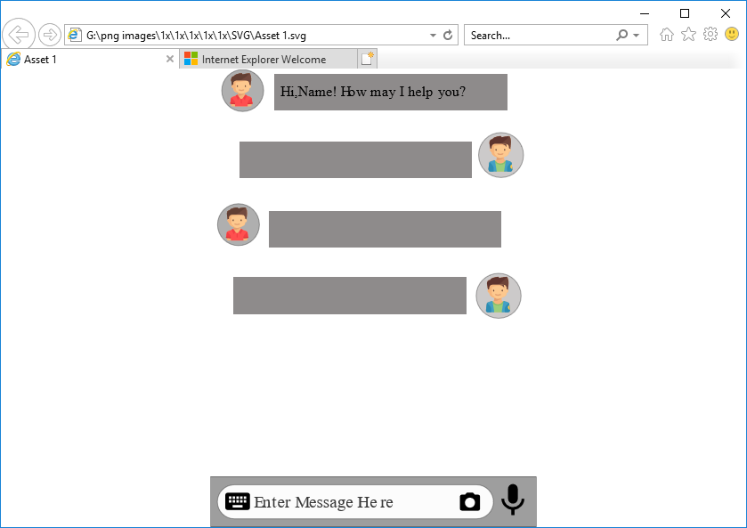
Cont..

Slide 31
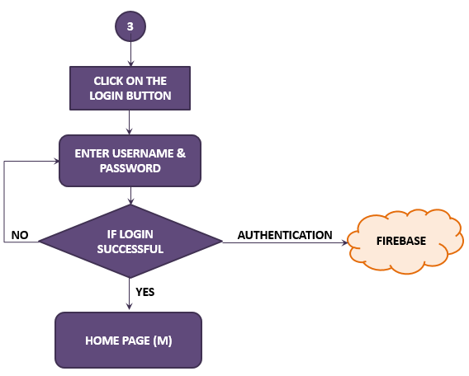
MoTA LOGIN
The user name and password for the MoTA agencies are provided by the government (admin.).
If the user is authenticated user the login will be successful or else the login fails.
Once logged into the application, they can use it.

Slide 32
HOW THE DETAILS ARE ORGANIZED IN DATABASE

Slide 33
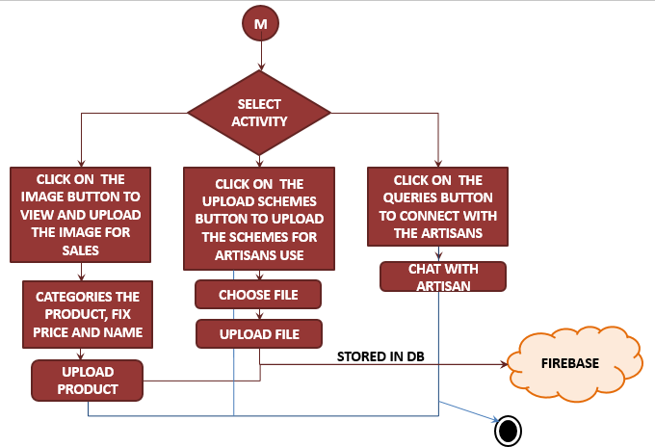
HOME PAGE OF MoTA

Slide 34
Description
The MoTA agencies can upload the schemes for the artisan use.
They can view the products made by the tribal people and categories the products. After categorizing the product the image can be uploaded along with the details like name, category and prize.
The image uploaded by the artisan is retrieved using image URL from the firebase storage.
Then the MoTA can communicate among the tribal people in the chat section provided.

Slide 35
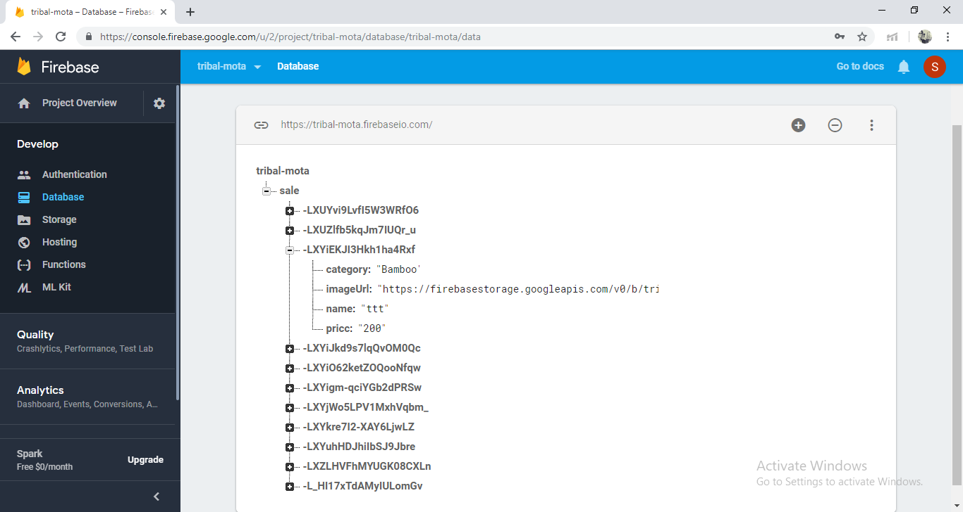
HOW THE DETAILS ARE ORGANIZED IN DATABASE

Slide 36
HOW THE UPLOADED IMAGES ARE ORGANIZED IN STORAGE

Slide 37
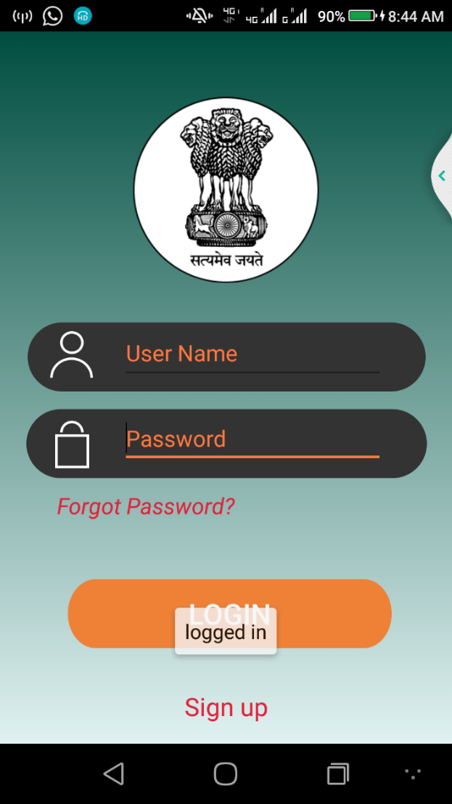
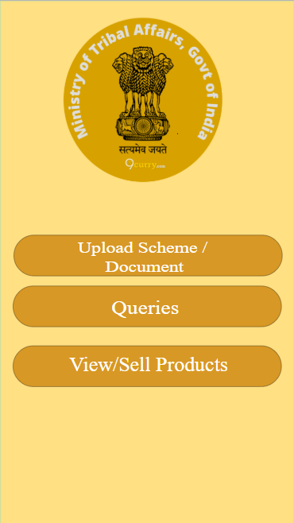
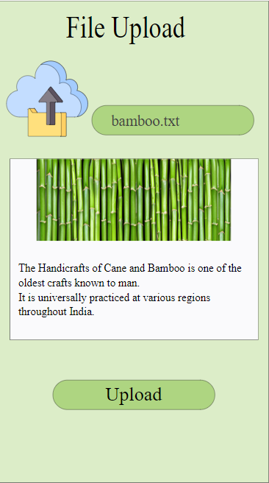
SCREENSHOTS OF MoTA

Slide 38
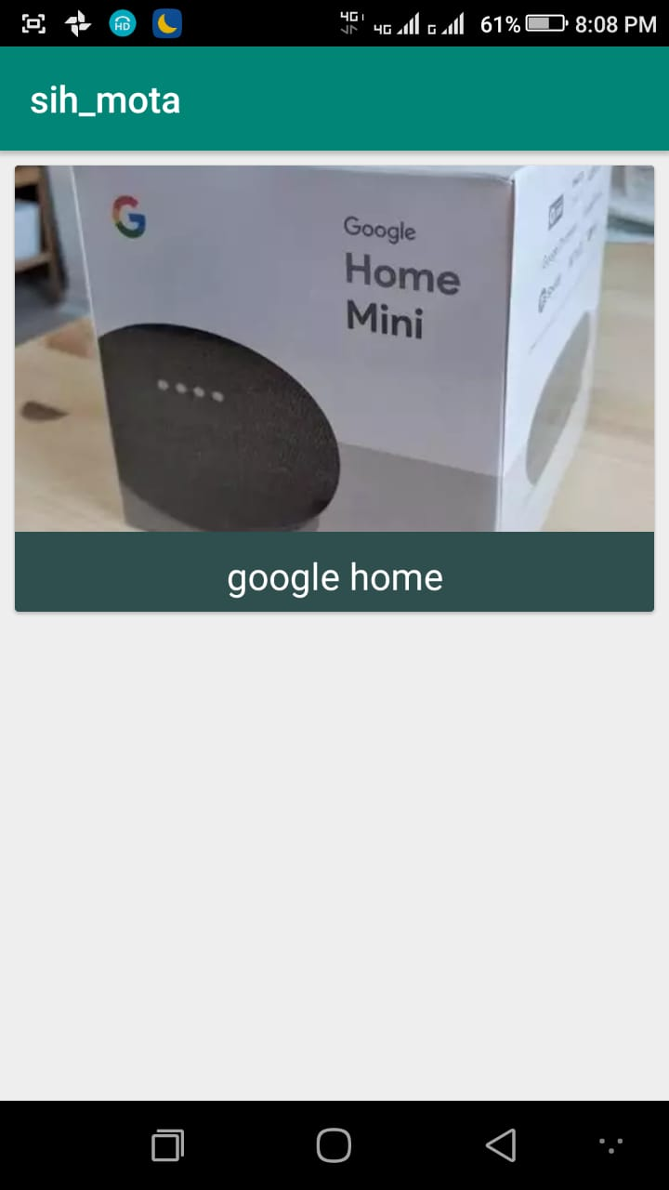
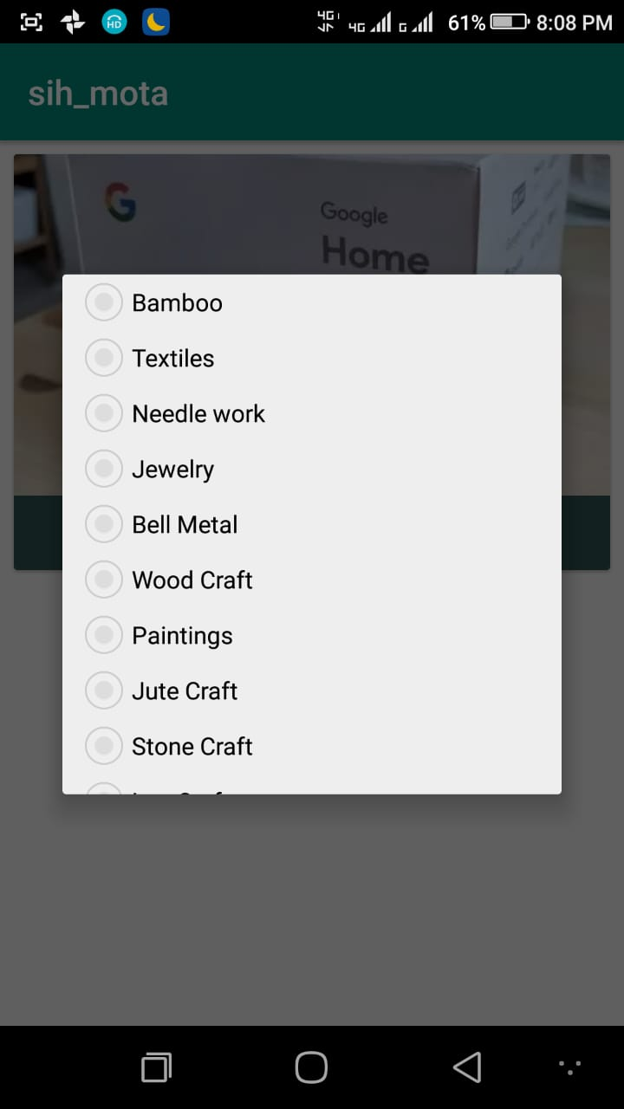
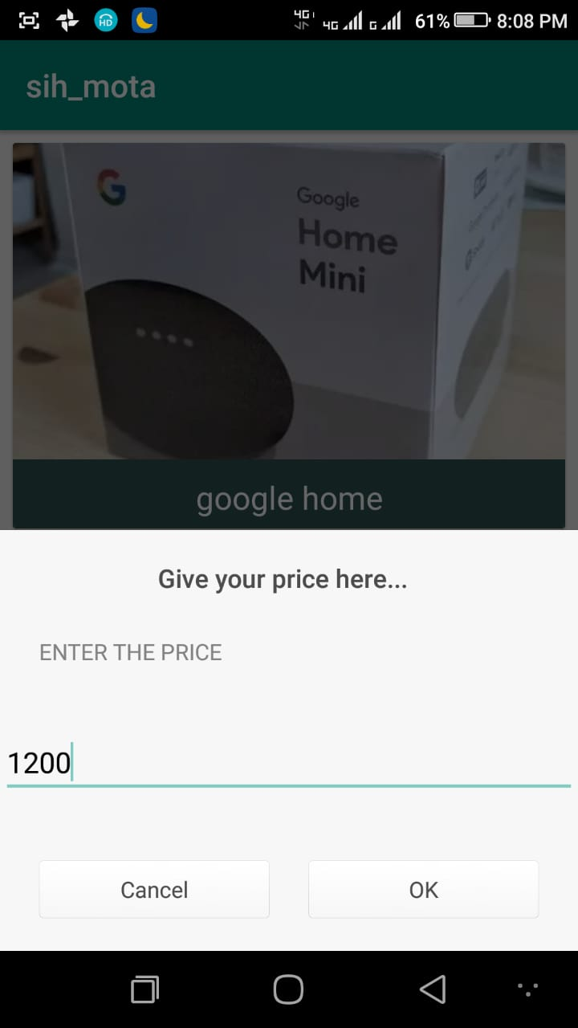
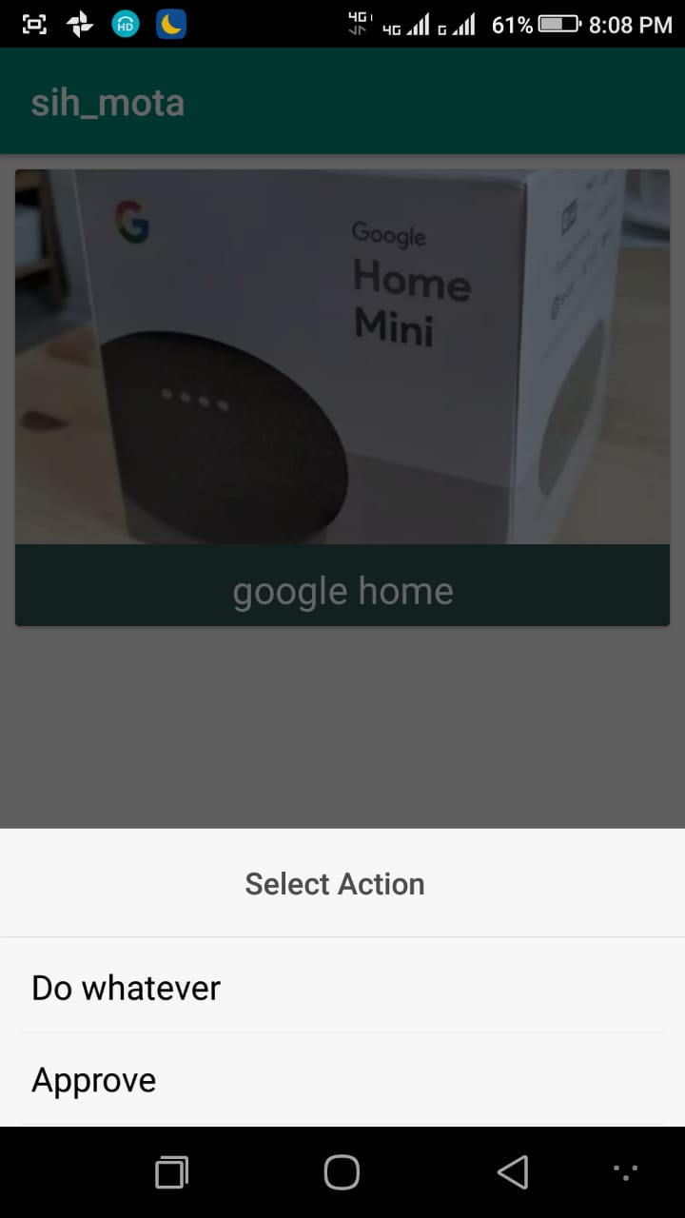
Cont..

Slide 39
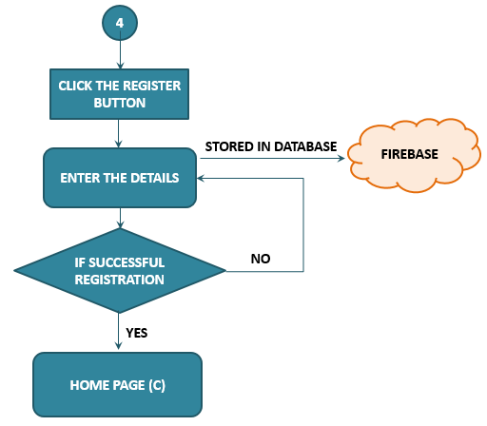
COMMONER’S REGISTRATION
To register as a new user the commoners need to click the register button.
After clicking the button the details (Username, Mobile number, Password, Location, DOB, Gender) must be filled.
The Username and password acts as a login credential for the Commoners.
The details will be stored in the Firebase Database.

Slide 40
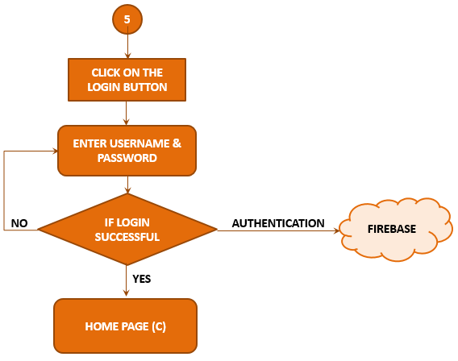
COMMONER’S LOGIN
The user name and password is used for logging in as a commoner.
If the user is authenticated user the login will be successful or else the login fails.
Once logged into the application, they can use it.

Slide 41
HOW THE DETAILS ARE ORGANIZED IN DATABASE

Slide 42
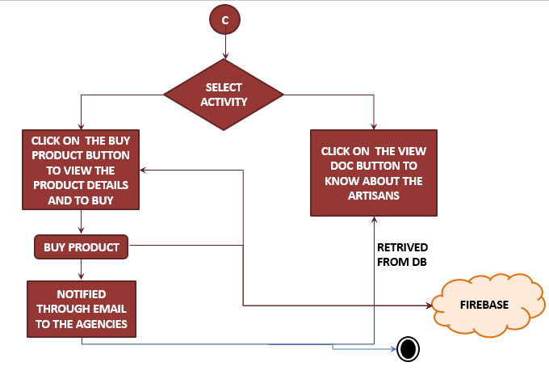
HOME PAGE OF COMMONER

Slide 43
Description
The commoners can view the products, if interested they can buy the products.
While clicking on the buy now button the information of the commoner is obtained from the database and sent as a notification to the agency who uploaded the product.
The commoners can also view the document uploaded by the MoTA.

Slide 44

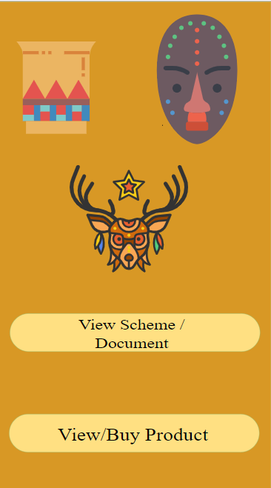
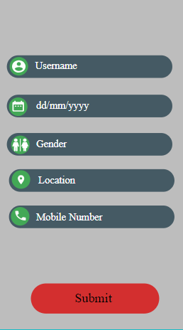
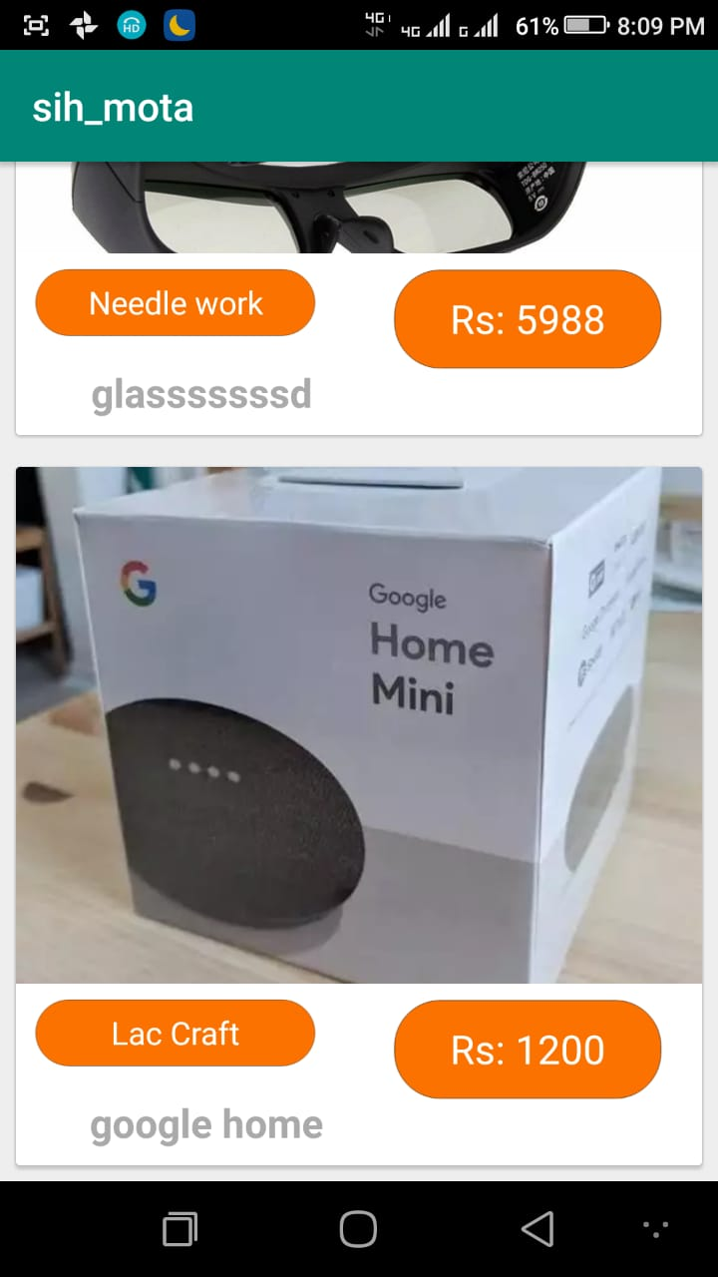
SCREENSHOTS OF COMMONER

Slide 45
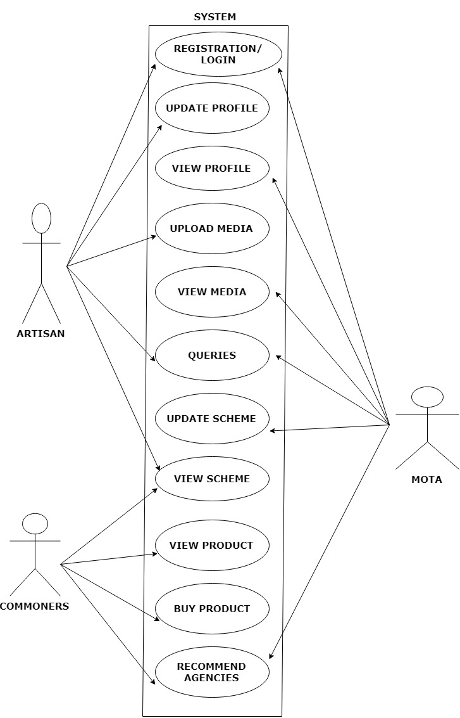
USECASE DIAGRAM

Slide 46
FUTURE ENHANCEMENT
To provide the application with multiple Indian languages on the artisan’s side.
Payment gateway must be established.
Live tracking of the products ordered.
Filtering the products, in the commoners user interface.

Slide 47
CONCLUSION
The shift towards the technology will lead to a greater impact on the people by providing many beneficiaries for them.
Both literate and illiterate people are adapting the technical growth of the country.
A direct link between the local artisans and the agencies of MoTA is made complicated.
This project makes the tribal people easier to use and access them better than any other mobile application in order to reach out the agencies of MoTA.

Slide 48
Cont..
This project helps the local artisan to develop their skills to advancement, as well as promote their skills for their welfare.
The MoTA (Government) Agencies could use this project easily to provide training, promotions and marketing to the tribal people directly by viewing their work of arts and queries. And may also help the commoners to know more about the art and culture of the tribal people.
The commoners also plays a major role in the economic betterment of the artisans. They can also gain some knowledge about the tribes of India. Hence, this application can bring a change in the socio-economic life of the tribal people.

